Slide 1

EDA on Movie Dataset

Slide 2
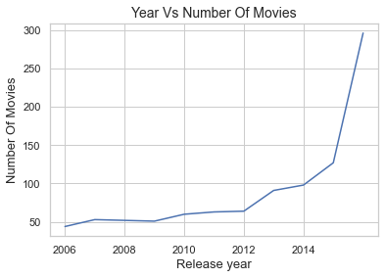
Year with the Highest Movies Released
Year 2016 has the highest release of movies (296) followed by year 2015 (127) and year 2014 (98)
Year 2006 has the least number of movies released (44)
However, the trend for the release of movies from the year 2006 to 2014 almost shows a steady increase with a sudden spike in the year 2015 (127) and year 2016 (296)

Slide 3
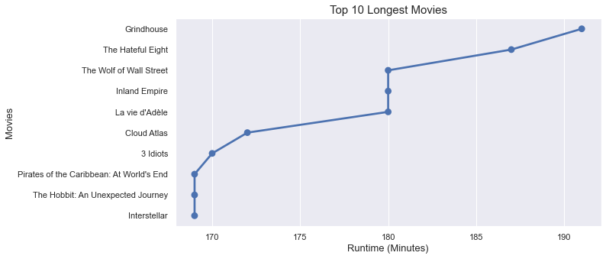
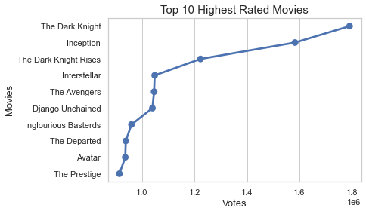
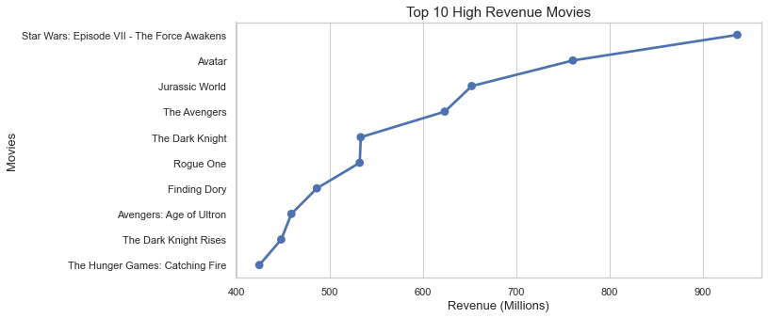
Top 10 Movies

Slide 4
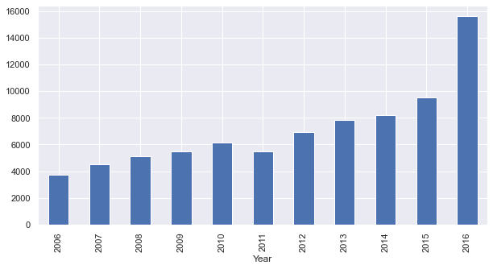
Growth Trend in Revenue (Millions) over the years
The number of movies released does make an impact in the Revenues for the year. Year 2016 being the year for the highest release of movies (296) does impact on a significant rise in the Revenues for the same year.

Slide 5
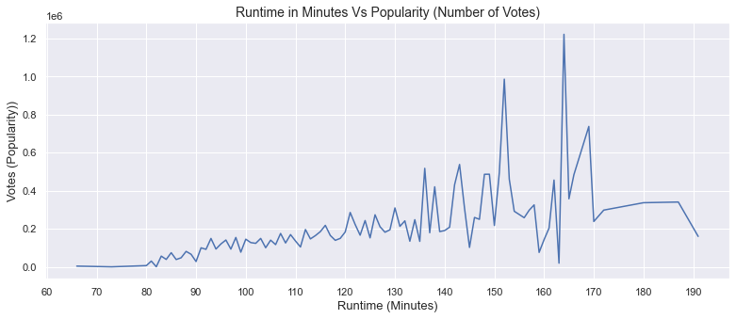
Impact of Movies Length analysed by Audience Popularity
Movies in the range of 120-150 minutes runtime are more popular than other runtime movies. This could be linked to the fact that the human attention span is limited and cannot relate to long duration movies. One can get bored beyond a certain time.

Slide 6
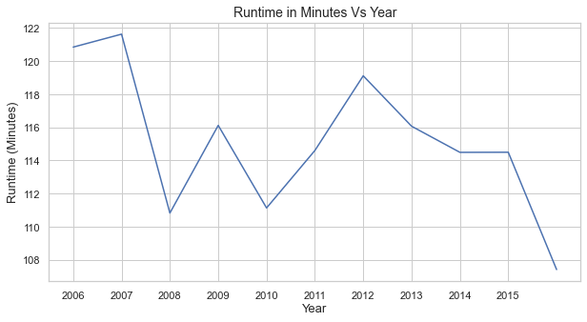
Average Runtime of Movies Year to Year
An interesting revelation through this plot. It is no surprise to see this visualizaiton as we have already seen that the average runtime of 120-150 minutes is the most popular choice of people. People are not engaged beyond a certain timeframe and so it is important to plan movies around 120 to 150 minutes which is indicative in this visualization too.

Slide 7
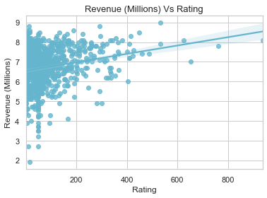
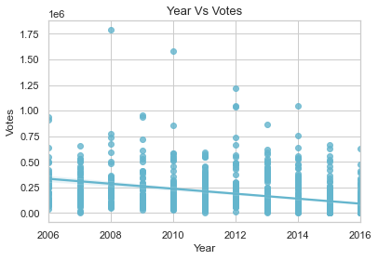
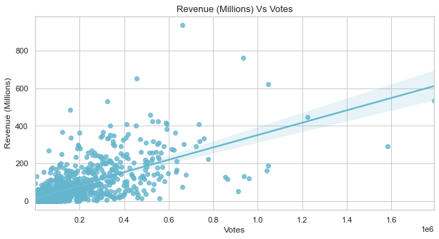
Relationship between Revenue & Votes, Year & Votes and Rating & Revenue
Votes (Popularity) and Rating Vs Revenue (Millions) have positive correlation which means that movie with high votes and high rating tends to earn high revenue
Year Vs Votes have a negative correlation which means that Votes does not depend on the year the movie is release

Slide 8
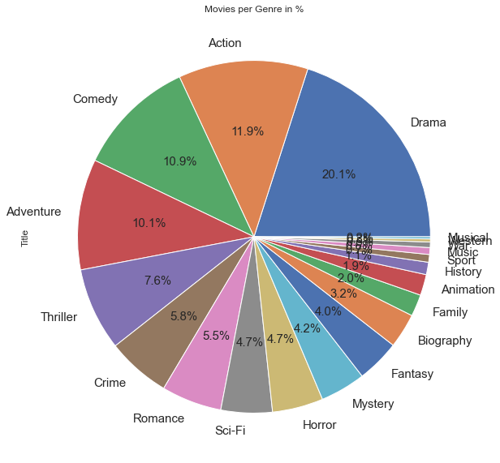
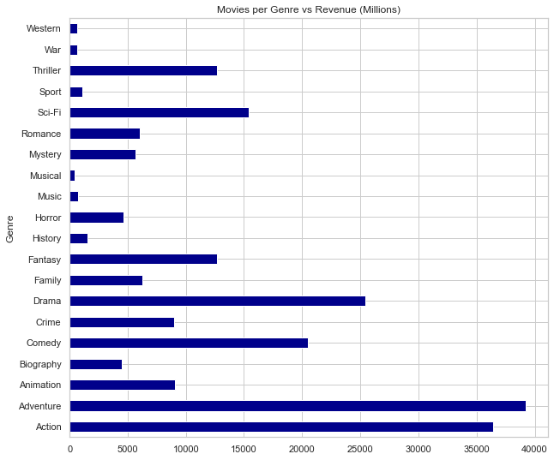
Common Genres (Number of Movies made)
The most common genres in terms of movies released and highest revenue earners are Drama, Action, Comedy and Adventure
The Genre with the highest revenue is Adventure with a revenue of 39188.75 MUSD while the one with the least revenue is Musical with a revenue of 408.21 MUSD

Slide 9

Most Frequent Actor
We could not establish if the choice of the Actor matters in the success of the movie however what we can say post studying the dataset that a combination of many factors drives the success of a movie that includes - Genre, Storyline, Runtime, Actors and the right Director to lead the project.

Slide 10
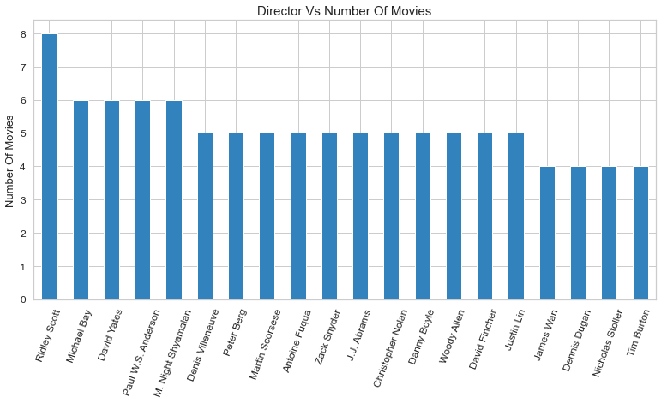
Top 20 Directors who have directed maximum movies
We could not establish if the choice of the Director matters in the success of the movie however what we can say post studying the dataset that a combination of many factors drives the success of a movie that includes - Genre, Storyline, Runtime, Actors and to execute all this the Director does play a major role.

Slide 11
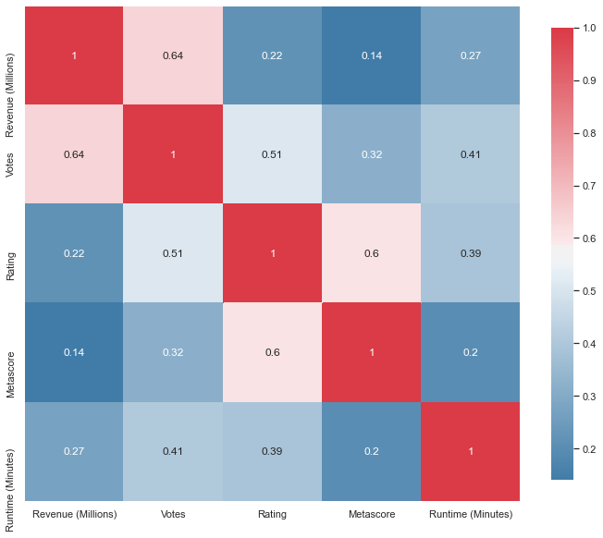
Properties Associated with Movies with High Revenues
Plot 1: Votes vs Revenue (Millions) - We can safely assume that the Revenue seems to be increasing with the increases in Votes which can be linked to popularity too. We can thus conclude that if the popularity of a movie is high then the revenue of the movie may be high. Correlation = 0.64
Plot 2: Rating vs Revenue (Millions) - The correlation between Revenue and Rating is 0.22. So the Rating is not highly related to the Revenue.
Plot 3: Runtime (Minutes) vs Revenue (Millions) - The correlation between Revenue and Runtime is 0.27. So Runtime is not highly related to the Revenue.

Slide 12
Conclusion
The most revenue earning movies are those that belong to the Genres of Adventure, Action, Drama and Comedy and incidentally it is also observed that the same Genres are the most popular too
We could not establish if the choice of the Director or Actors matters in the success of the movie however what we can say post studying the dataset that a combination of many factors drives the success of a movie that includes - Genre, Storyline, Runtime, Actors and to execute all this the Director does play a major role
Directors must direct their efforts to release movies that have been analysed as the most revenue earning and popular genres
Movies with high rating and high votes tends to earn high revenues so it is important to have a good story line with an engaging star cast
Viewers love short to mid duration movies so we can presume that the success of the movie is dependent on the length as the rating and voting will be directly linked to this factor

Slide 13
Movie with the Highest & Lowest Earned Revenue (Millions)
Star Wars: Episode VII - The Force Awakens directed by J.J. Abrams earns the highest revenue in all, making 936.63 MUSD revenues.
The Least revenue reported is Dead Awake, with a revenue of 0.01 MUSD directed by Phillip Guzman.
The range of the Top 10 High Revenue Movies is between 420 – 937 MUSD.

Slide 14
Movie with the Highest & Lowest Votes
The Dark Knight directed by Christopher Nolan has the highest votes with 1791916
Paint It Black directed by Amber Tamblyn has the lowest votes with 61

Slide 15
Movie with the Longest & Shortest Runtime (Minutes)
Grindhouse has the highest runtime with 191 minutes
Ma vie de Courgette has the lowest runtime with 66 minutes
The range of the Top 10 Longest Movies is between 162 to 192 minutes.

